Slide 1
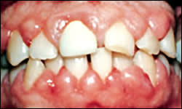
GINGIVAL ENLARGEMENT
RUNGTA COLLEGE OF DENTAL SCIENCES AND RESEARCH,BHILAI
Dr PUSHPENDRA YADAV
Senior Lecturer
Dept of Periodontology

Slide 2
SPECIFIC LEARNING OBJECTIVES
CORE AREAS | DOMAIN | CATEGORY
INTRODUCTION | Affective | Desire to know
CLASSIFICATION | Cognitive | Must to know
INFLAMMATARY ENLARGEMENT | Cognitive | Must to know
DRUG INDUCED ENLARGEMENT | Cognitive | Must to know
IDIOPATHIC ENLARGEMENT | Cognitive | Must to know
ENLARGEMENTS ASSOCIATED WITH SYSTEMIC DISEASES | Cognitive | Must to know
NEOPLASTIC ENLARGEMENT | Cognitive | Must to know
FALSE ENLARGEMENT | Cognitive | Must to know

Slide 3
CONTENT
PART-I
Introduction
Classification
Inflammatory enlargement
Chronic
Acute
PART--II
Drug-induced enlargement
Anti-Convulsants
Immunosuppresants
Calcium Channel Blockers

Slide 4
Idiopathic Gingival enlargement
PART-III
Enlargements associated with systemic diseases or conditions
Neoplastic enlargements
False enlargement
Summary
Reference

Slide 5
Enlargement in vitamin C deficiency:
Acute vitamin C deficiency itself does not cause gingival inflammation, but it does cause hemorrhage, collagen degeneration, and edema of the gingival connective tissue.
These changes modify the response of the gingiva to plaque to the extent that the normal defensive delimiting reaction is inhibited, and the extent of the inflammation is exaggerated, resulting in the massive gingival enlargement seen in scurvy.

Slide 6
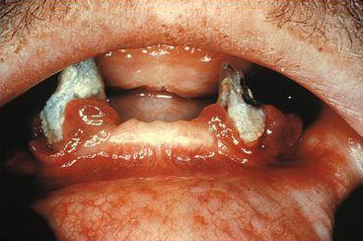

Slide 7
Clinical features:
Gingival enlargement is marginal, bluish red, tender, soft and friable, and has smooth and shiny surface
Extremely hyperemic and bleed spontaneously or on gentle stimulation, such as on chewing.
Ulcerations or surface necrosis with pseudomembrane formation
Alveolar bone resorption with increased tooth mobility has been described.

Slide 8
Plasma cell ginigvitis:
rare, non-symptomatic erythematous and edematous reaction to various substances
Synonym: Atypical gingivitis
Plasma cell gingivostomatitis
Localized – plasma cell granuloma
Etiology: allergic in origin

Slide 9
Substances resulting in allergy are:
Chewing gum additives such as:
Cinnmonaldehyde
Cinnamon oil
Dichlorophene
Hexylresorcinol
Mint
Dentrifices
Various dietary components

Slide 10
Clinical features:
The gingiva appears red, friable, and sometimes granular and bleeds easily;
usually it does not induce a loss of attachment
often consists of a mild marginal gingival enlargement that extends to the attached gingiva

Slide 11
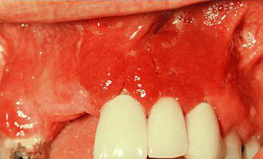
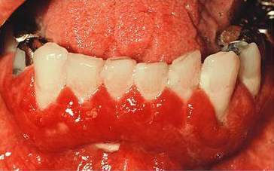

Slide 12
Non-specific conditioned enlargement (Pyogenic Granuloma):
It is a tumor like gingival enlargement
considered as an exaggerated conditional response to minor trauma
The exact nature of systemic conditioning factor is not known
Recurrence rate is about 15%

Slide 13
Clinical features :
The lesion varies from a discrete spherical, tumorlike mass with a pedunculated attachment to a flattened, keloidlike enlargement with a broad base.
It is bright red or purple and either friable or firm, depending on its duration; in the majority of cases it presents with surface ulceration and purulent exudation.
The lesion tends to involute spontaneously to become a fibroepithelial papilloma, or it may persist relatively unchanged for years.

Slide 14
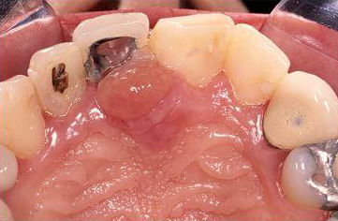
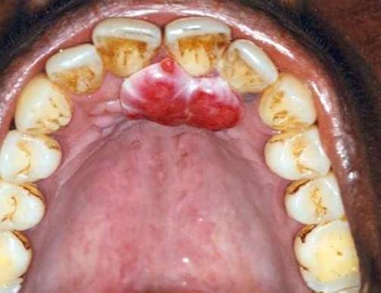

Slide 15
Systemic Diseases causing Gingival Enlargement
Leukaemia
Leukemia does not cause the gingivitis but the lowered resistance to infection due to lack of normal functioning leukocytes tends to aggravate already present gingivitis and the increased bleeding tendency

Slide 16
Gingiva is generally bluish red and has a shiny surface.
The consistency is moderately firm, but there is a tendency toward friability and hemorrhage, occurring either spontaneously or on slight irritation.

Slide 17
Consistency is moderately firm but there is tendency toward friability and hemorrhage occurring either spontaneously or on slight irritation
Acute painful necrotizing ulcerative inflammatory involvement sometimes occurs in the crevice formed at the junction of the enlarged gingiva and the contigous tooth surface
Patients with leukemia may also have simple chronic inflammation

Slide 18
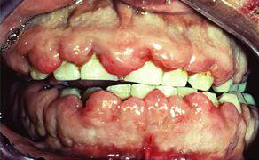
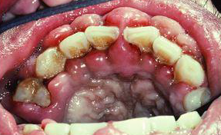

Slide 19
Granulamatous diseases – Wegener’s granulamatosis
rare disease
characterized by acute granulomatous necrotizing lesions of the respiratory tract, including nasal and oral defects

Slide 20
Etiology:
unknown but the condition is considered an immunologically mediated tissue injury
development of renal lesion and acute necrotizing vasculitis affecting the blood vessels
The use of immunosuppressant in case of renal failure

Slide 21
Clinical presentation:
Initially involves the orofacial region and includes
oral mucosal ulceration, gingival enlargement, abnormal tooth mobility, exfoliation of teeth and delayed healing response
reddish purple
bleeds easily on stimulation

Slide 23
Granulamatous diseases – Sarcoidosis
unknown etiology
Starts at- 20s or 30s
Predominantly affects blacks
Involve almost any organ
Gingiva appear red, smooth, painless
It presents most frequently with hilar lymphadenopathy, pulmonary inflammation and skin & eye lesions
There is depression of delayed type hypersensitivity

Slide 24
NEOPLASTIC ENLARGEMENT BENIGN TUMORS

Slide 25
Epulis is a generic term used clinically to designate all discrete tumors and tumorlike masses of the gingiva
Most lesions referred to as "epulis" are inflammatory rather than neoplastic

Slide 26
FIBROMA:
Fibromas of the gingiva arise from the gingival connective tissue or from the periodontal ligament.
slow-growing, spherical tumors that tend to be firm and nodular but may be soft and vascular.
usually pedunculated.

Slide 27
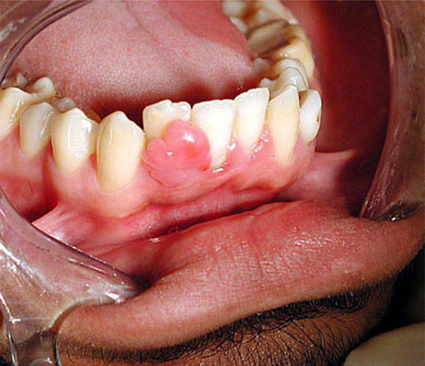

Slide 28
PAPILLOMA:
Papillomas are benign proliferations of surface epithelium associated with the human papillomavirus (HPV)
subtypes HPV6 and HPV11
Gingival papillomas appear as solitary, wartlike or cauliflower-like protuberances. They may be small and discrete or broad, hard elevations with minutely irregular surfaces .

Slide 29
PERIPHERAL GIANT CELL CARCINOMA:
Unknown etiology
arise interdentally or from the gingival margin
Occurs on the labial surface
may be sessile or pedunculated
They may be firm or spongy, and the color varies from pink to deep red or purplish blue.

Slide 30
smooth, regularly outlined masses to irregularly shaped, multilobulated protuberances with surface indentations.
Ulceration of the margin is occasionally seen.
painless,
vary in size, and may cover several teeth.

Slide 31
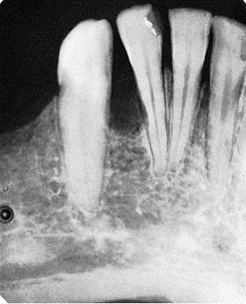
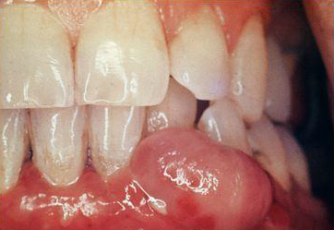

Slide 32
CENTRAL GIANT CELL CARCINOMA:
These lesions arise within the jaws and produce central cavitation
They occasionally create a deformity of the jaw that makes the gingiva appear enlarged

Slide 33
GINGIVAL CYST:
localized enlargements
may involve the marginal and attached gingiva
Site: mandibular canine and premolar areas, most often on the lingual surface
Painless but with expansion, they may cause erosion of the surface of the alveolar bone

Slide 34
MALIGNANT TUMORS
Carcinoma:
Oral cancer constitutes only 3% of all malignant tumors in the body
6% of oral malignancy have gingiva as their site
Squamous cell carcinoma is the most common

Slide 35
Squamous cell carcinoma:
It may be exophytic, presenting as an irregular outgrowth, or ulcerative, appearing as flat, erosive lesions.
It is often symptom free, going unnoticed until complicated by inflammatory changes that may mask the neoplasm but cause pain; sometimes it becomes evident after tooth extraction.

Slide 36
Malignant melanoma:
rare oral tumor
occur in the hard palate and maxillary gingiva of older persons.
It is usually darkly pigmented and is often preceded by localized pigmentation.

Slide 37
It may be flat or nodular and is characterized by rapid growth and early metastasis.
It arises from melanoblasts in the gingiva, cheek, or palate.
Infiltration into the underlying bone and metastasis to cervical and axillary lymph nodes are common.

Slide 38
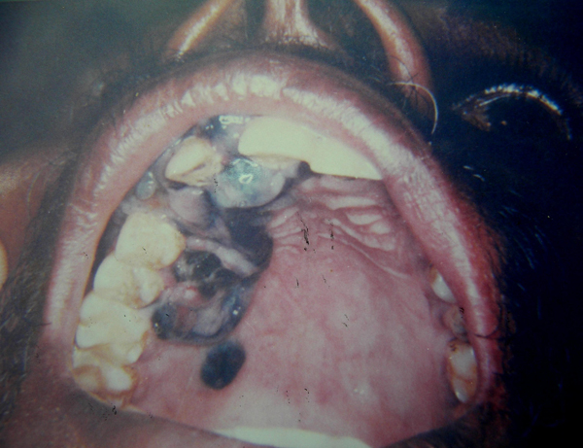
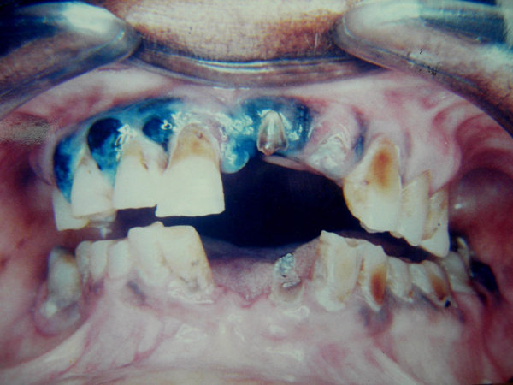

Slide 40
FALSE ENLARGEMENT
result of increases in size of the underlying osseous or dental tissues
no abnormal clinical features except the massive increase in size of the area

Slide 41
Underlying Osseous Lesions:
Tori and exostoses
Paget’s disease
Fibrous dysplasia
Cherubism
Central giant cell granuloma
Ameloblastoma
Osteoma
Osteosarcoma

Slide 42
Underlying Dental Lesions:
developmental gingival enlargements are physiologic and usually present no problems.

Slide 43
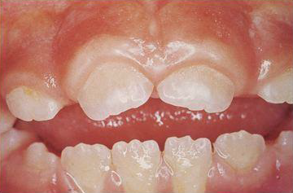

Slide 44
Summary
GE is one of the commonly encountered entity in the clinic & has various implications like niches for infection & esthetic concern
Diagnosis of the exact nature of enlargement & etiologic factor plays a critical role in elimination of exaggerated lesions

Slide 45
REFERENCE
Newman MG, Takei HH, Klokkevold PR, Carranza FA. Carranza’s clinical periodontology, 10th ed. Saunders Elsevier; 2007.
Lindhe J, Lang NP and Karring T. Clinical Periodontology and Implant Dentistry. 6th ed. Oxford (UK): Blackwell Publishing Ltd.; 2015.
Newman MG, Takei HH, Klokkevold PR, Carranza FA. Carranza’s clinical periodontology, 13th ed. Saunders Elsevier; 2018.

Slide 46
THANK YOU

